Slide 1
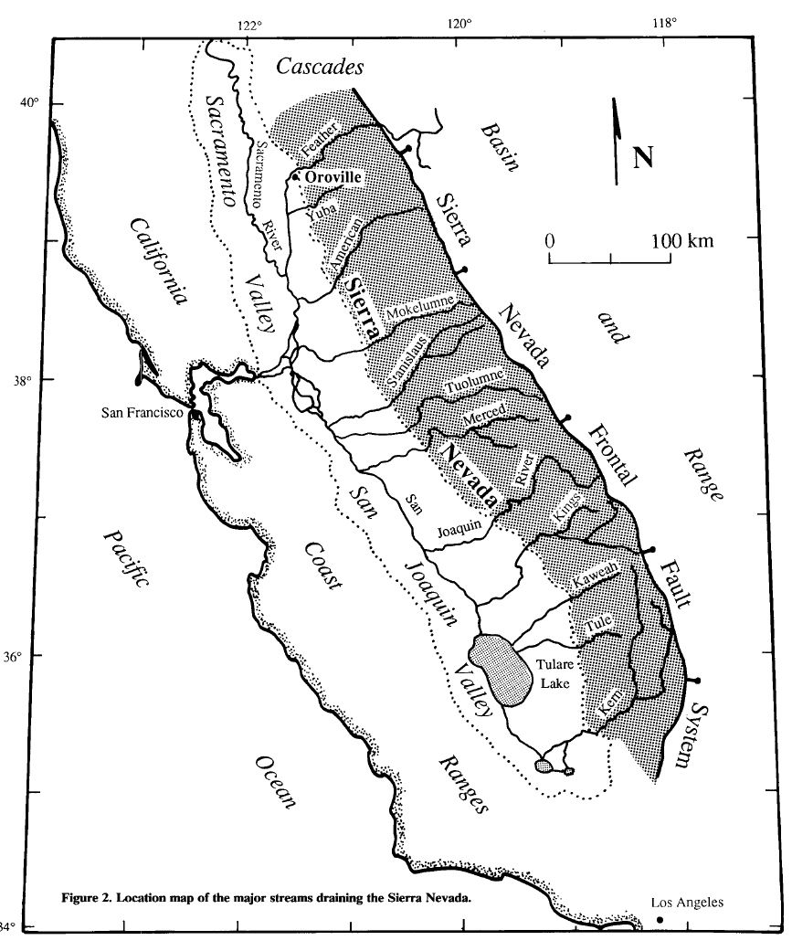
Late-Cenozoic Uplift of the Sierras: Timing and Origin
The Uplift of the Sierra Nevada and Implications for late Cenozoic epeirogeny in the western Cordillera by J.R. Unruh (1991)

Slide 2
“The timing, magnitude, and mechanics of the late Cenozoic uplift of the Sierra Nevada has been a matter of continuing controversy.”
Important for tectonic interpretations

Slide 3
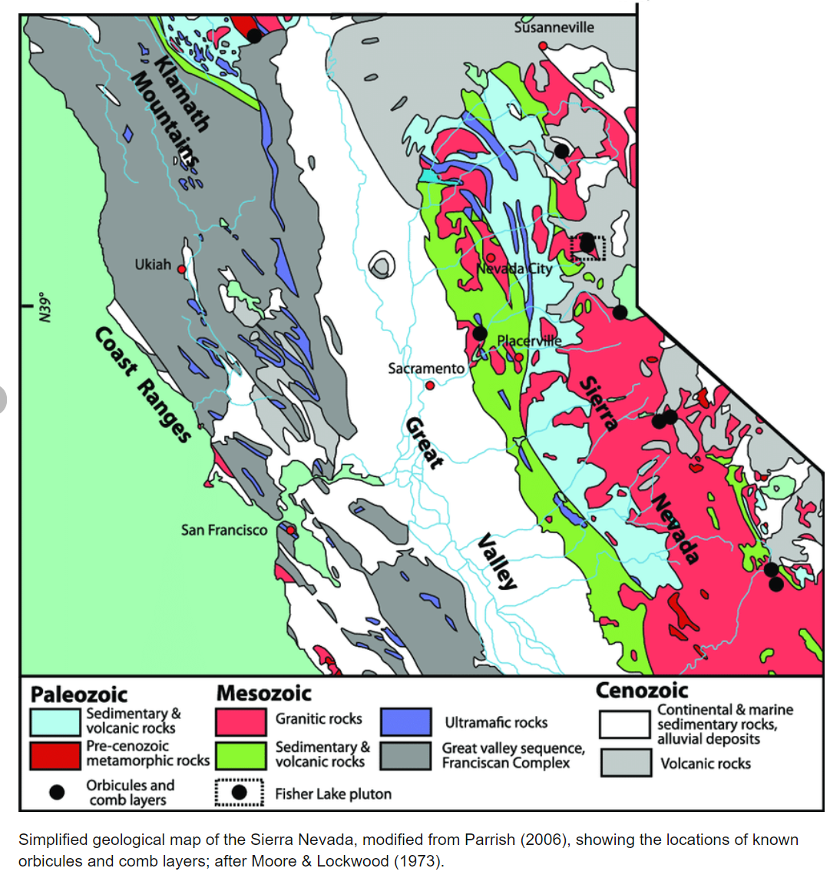
Evidence For Uplift: Early Cenozoic
Geomorphic and stratigraphic data support uplift predating the Eocene.
Large alluvial deposits, resting on Mesozoic granite and metamorphic rocks, date to the Eocene.
Barometric studies suggesting a formation depth of 8-12km for the plutons underlying the river deposits suggest that at least that much uplift had occurred by the Eocene.

Slide 4
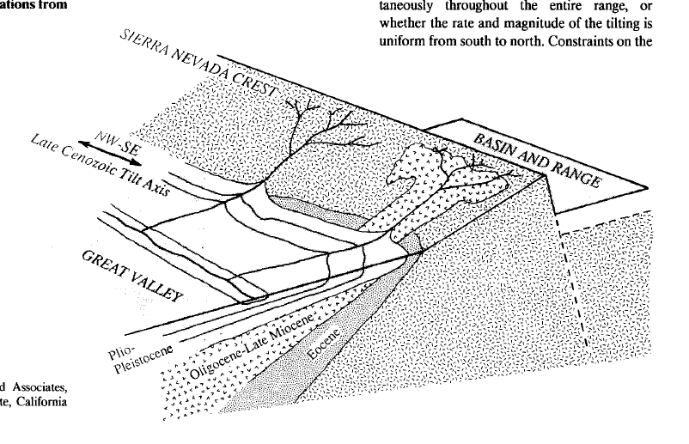
What about uplift in the Late Cenzozoic?
Workers have noted that Cenozoic strata in the Great Valley are tilted.
The degree of tilt (dip) increases with age
By assuming the tilt is related to the uplift of the Sierras, techniques can be used to deduce when uplift initiated.
Unruh, 1991

Slide 5
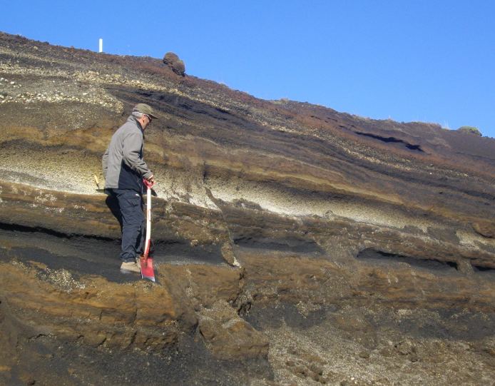
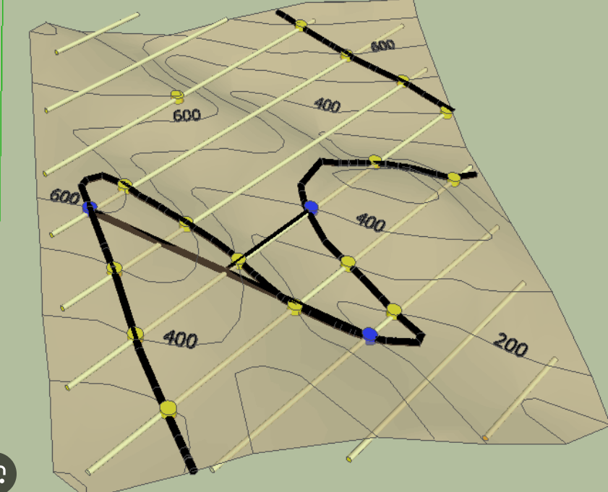
Data Acquisition Methods
Measuring strike/dip of well-exposed marker horizons and contouring the map patterns.
For recessive units, geomorphic landforms that correlate with certain units can be contoured
Three-point problems can be done on the contours to infer strike and dip
Downhole drill data was also used
From Wikipedia entry for “Marker Horizon”
From Williams University Department of Geosciences website

Slide 6
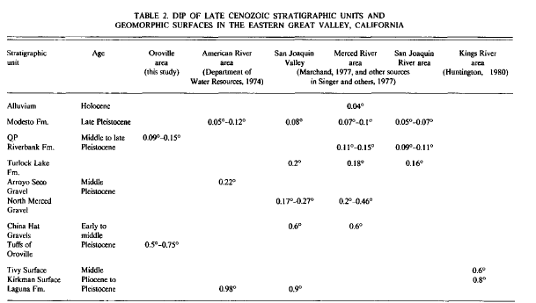
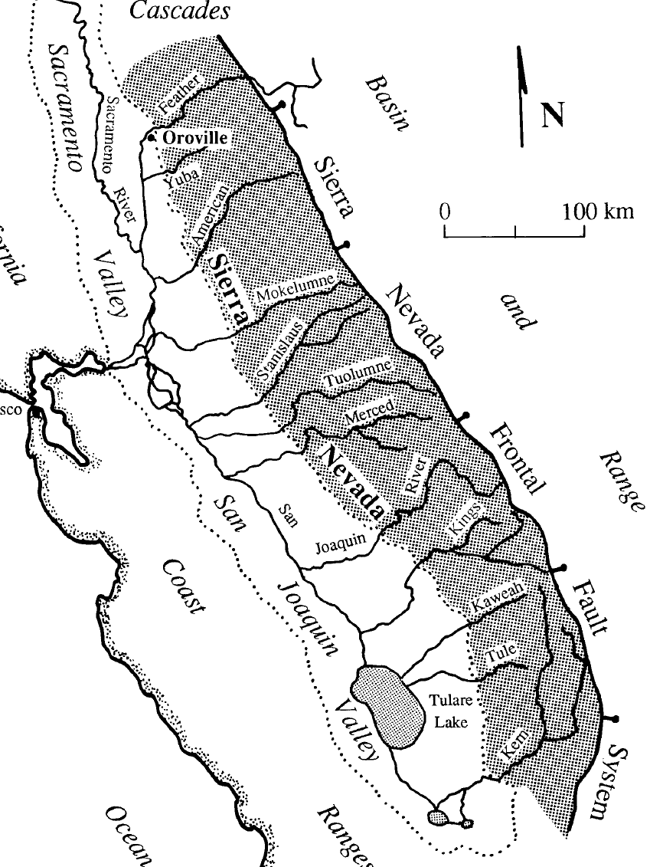
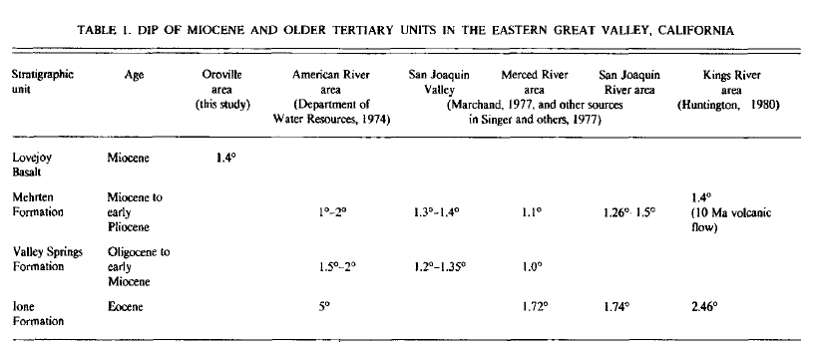
Observations
0.5 to .011 Ma
1.33 to 0.5 Ma
~1.33 Ma
2.6 – 1.33 Ma
5.33 - 2.6 Ma
Angular Unconformity
23.03 – 5.33 Ma
33.9 – 23.03 Ma
55.8 – 33.9 Ma
Collected by Unruh and other workers

Slide 7
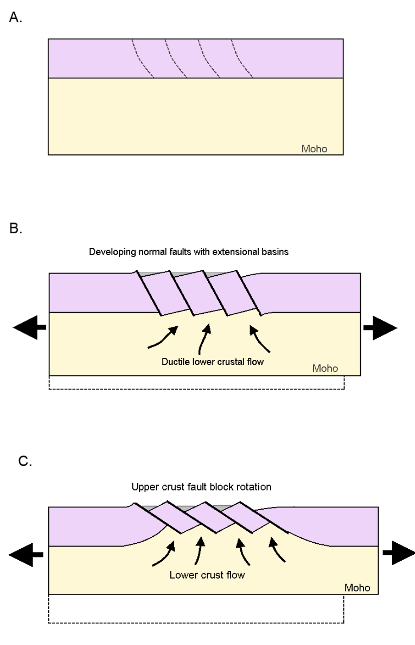
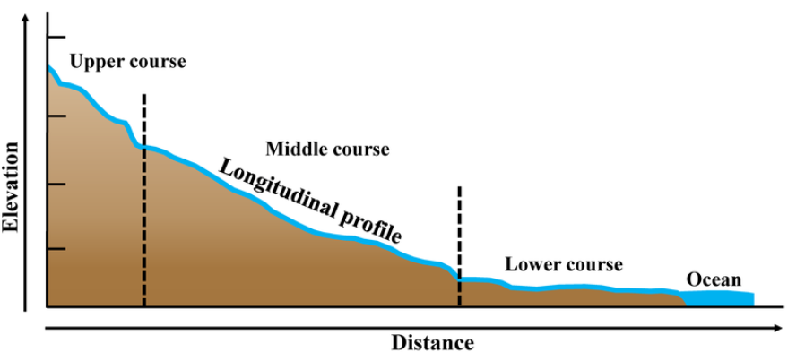
Moving from Observations to Interpretation: Key Assumption
The dips are interpreted to reflect uplift and westward tilting of the Sierra Nevada.
Not dips imparted by sedimentary depositional environments!
Supported by sedimentary facies. Slopes of graded streams are inversely proportional to discharge, and proportional to sediment load and caliber. Since units have similar textures and clast size through time, the tilt is likely not depositional-related.
Unruh does correct for Holocene depositional gradients
From Whitney and Others (2013)

Slide 8
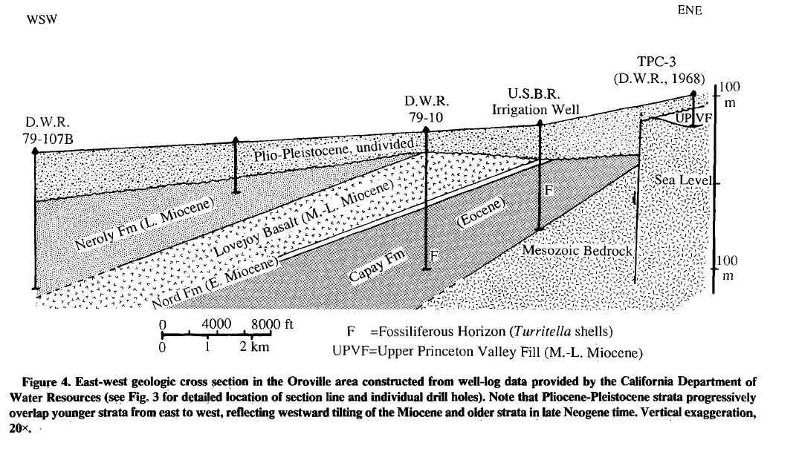
Chronologic Controls of Late Cenozoic Tilting: Neogene Unconformity
Neogene Unconformity
Plio-Pleistocene overling older strata in angular unconformity
Oldest radiometrically-dated Plio-Pleistocene unit above angular unconformity is 3.4 Ma
Youngest unit below angular unconformity that has been radiometrically dated is 8.4 Ma
This and other points of evidence bracket the event from ~4 to ~6 Ma

Slide 9
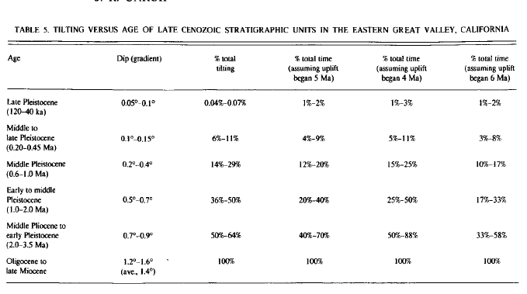
Working With the Data
1.4 degree dip is assumed to represent a reasonable average of tilting since uplift began in the Cenozoic
Results in uplift of 1950m for 80-km-long slopes
% total tilting and % time elapsed correlate better for 4 and 5 Ma, in contrast to 6 Ma.
Data suggests constant tilting/uplift rate

Slide 10
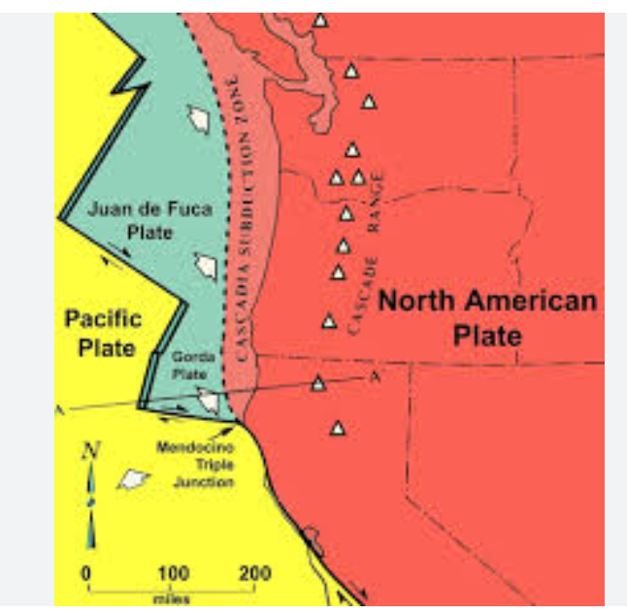
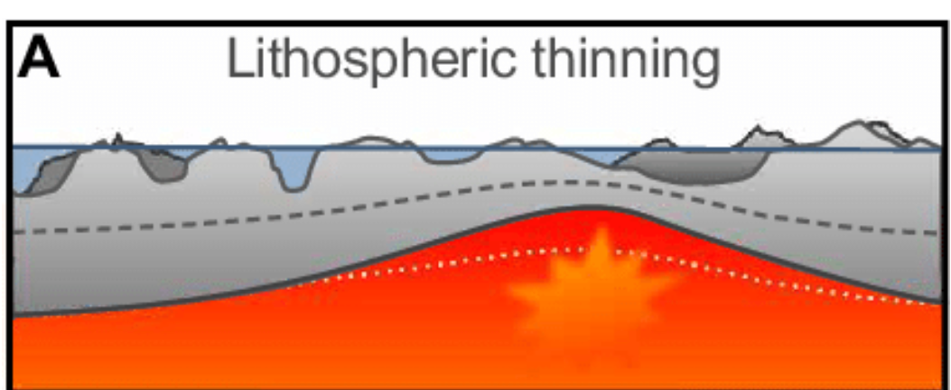
Big Picture Implications: Force behind Uplift
Uplift of the Sierra Nevada triggered by Northward Migration of the Mendocino Triple Junction
Tilting patterns don’t support this
Uplift of the Sierra as delay isostatic compensation of a Mesozoic crustal root
Assumes uplift began in late Cenozoic, so neglects Eocene uplift evidenced by field observations.
Uplift due to to thinning of mantle lithosphere
Doesn’t contradict any observations in this paper
?

Slide 11
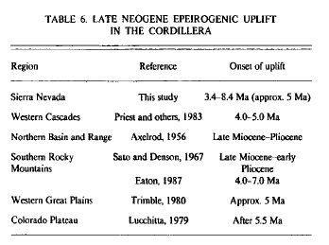
So what happened?
Unruh notes that the late Cenozoic uplift coincides with a period of uplift throughout the west – epeirogenic uplift
Epeirogenic uplift is defined as broad, slow, and mild uplift affecting a large region of a continent (typically craton)

